Slide 1

How to Really Use
Grammarly

Slide 2
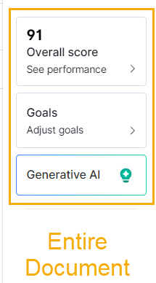
Entire Document

Slide 3
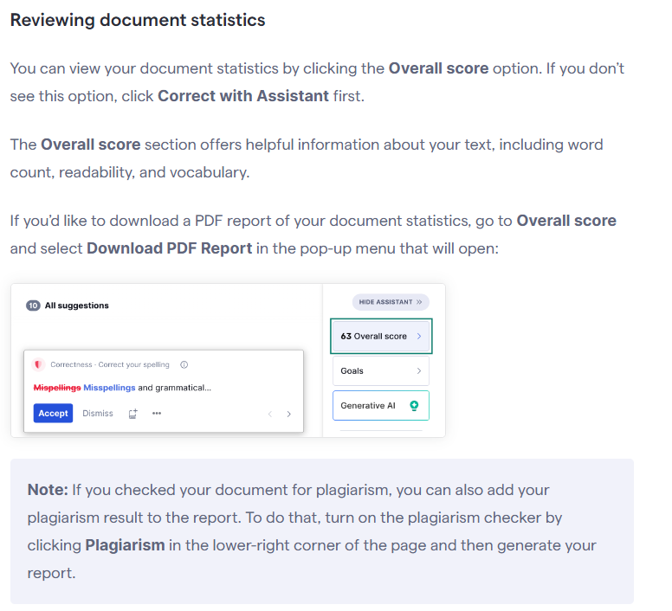
Overall Score
Notes:
https://support.grammarly.com/hc/en-us/articles/360003474732-Grammarly-Editor-user-guide

Slide 4
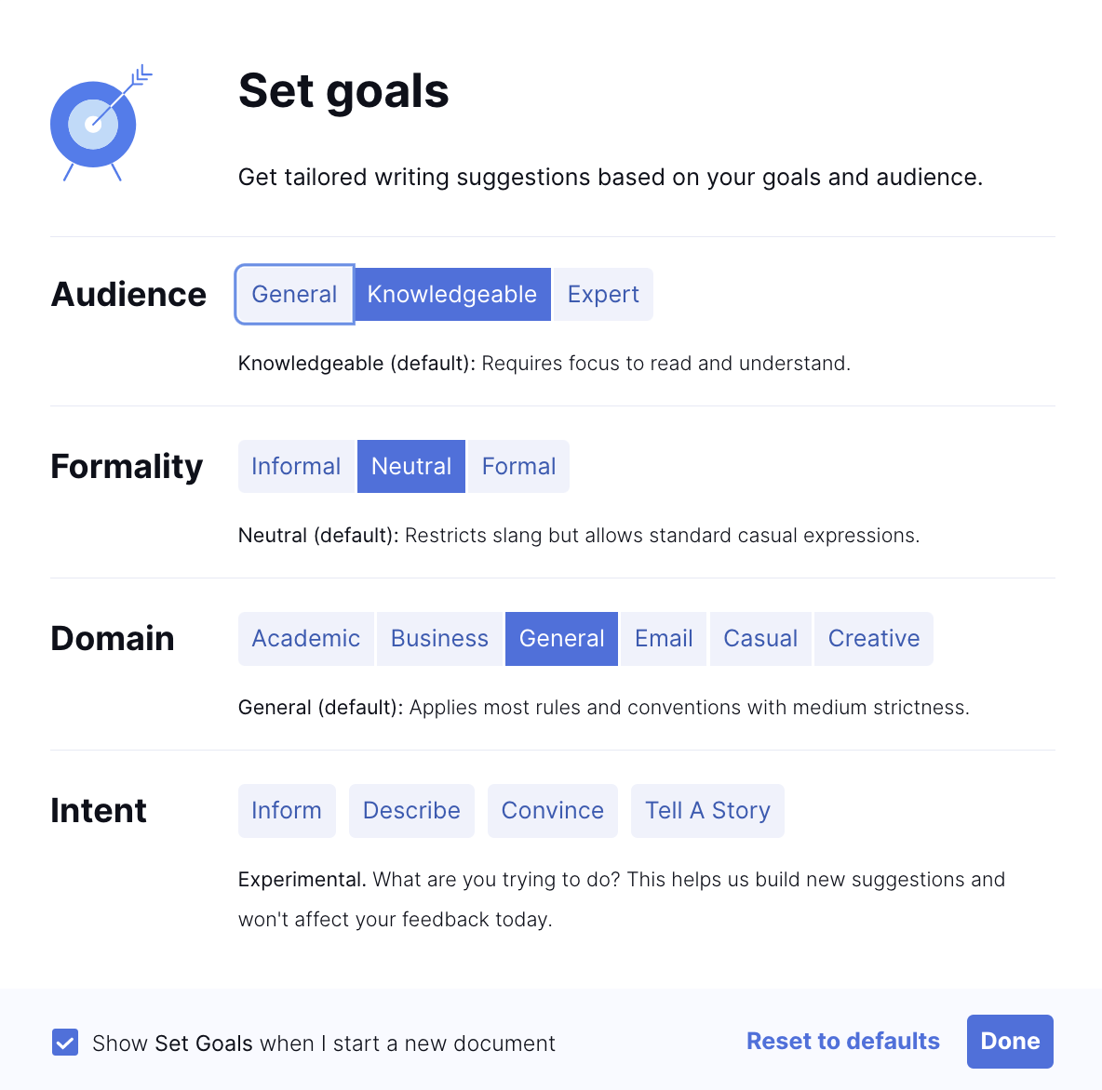
Setting Goals
Notes:
https://support.grammarly.com/hc/en-us/articles/360054679292-What-are-Goals

Slide 5




Notes:
https://www.youtube.com/channel/UC35ZpwldGw7ZJ5R-2sLijzw

Slide 6

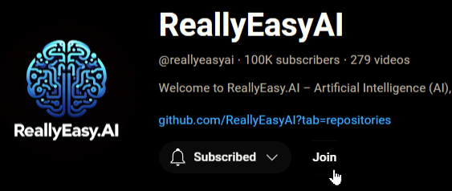
Membership has its privileges
Notes:
https://www.youtube.com/channel/UC35ZpwldGw7ZJ5R-2sLijzw/join

Slide 7

https://www.youtube.com/@AINewsFresh

Slide 8
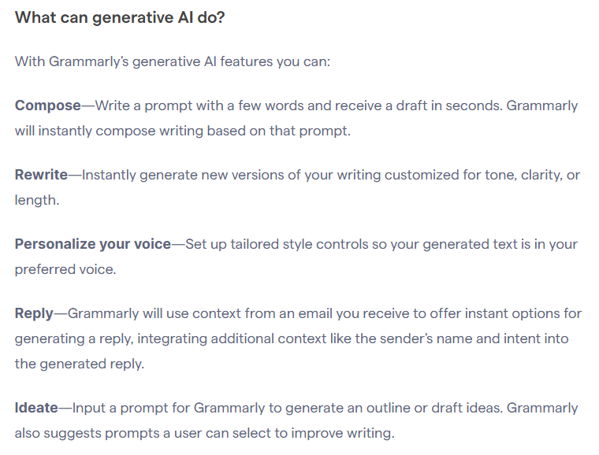
Generative AI
Notes:
https://support.grammarly.com/hc/en-us/articles/14528857014285-Introducing-generative-AI-assistance

Slide 9
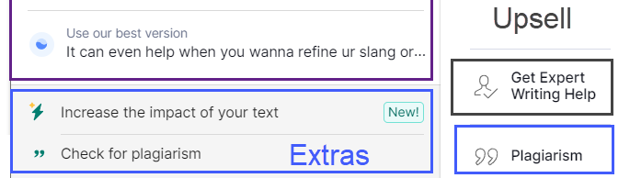
Extras & Upsell

Slide 10
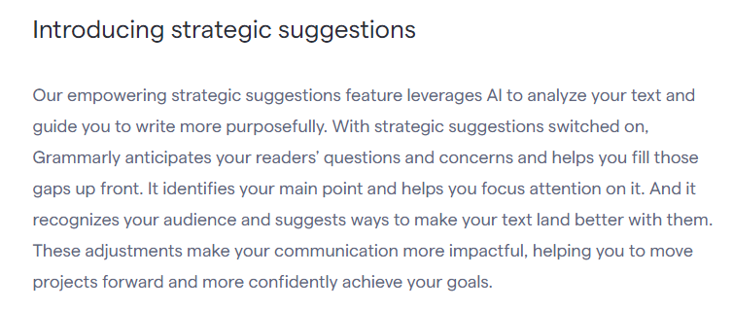
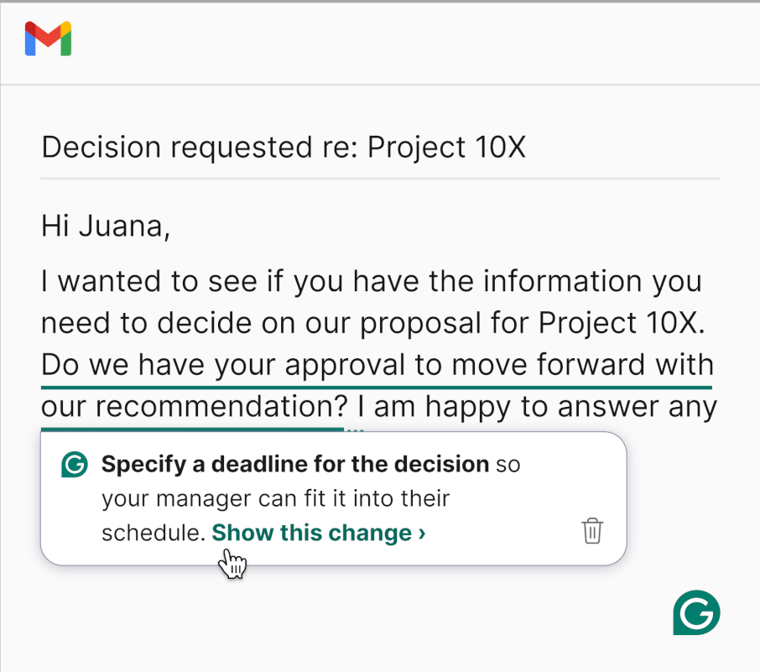

Increasing Impact
Notes:
https://support.grammarly.com/hc/en-us/articles/25351804320397-Introducing-strategic-suggestions
https://www.grammarly.com/blog/strategic-suggestions-anticipate-feedback

Slide 11
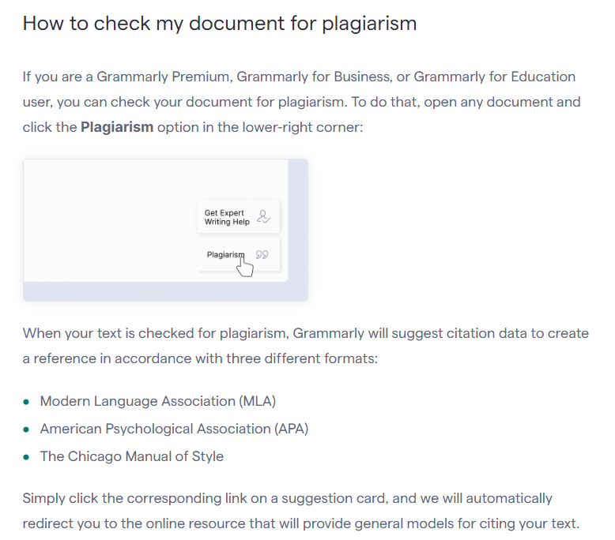
Plagiarism Check
Notes:
https://support.grammarly.com/hc/en-us/articles/115000091452-How-to-check-my-document-for-plagiarism

Slide 12
Expert Writing Help

Slide 13

Using Grammarly outside My Grammarly

Slide 14
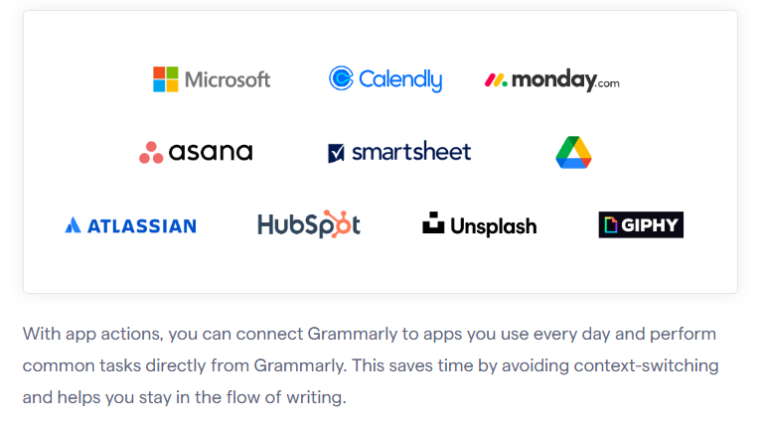
App Actions
Notes:
https://support.grammarly.com/hc/en-us/articles/21227721882253-Introducing-app-actions

Slide 15
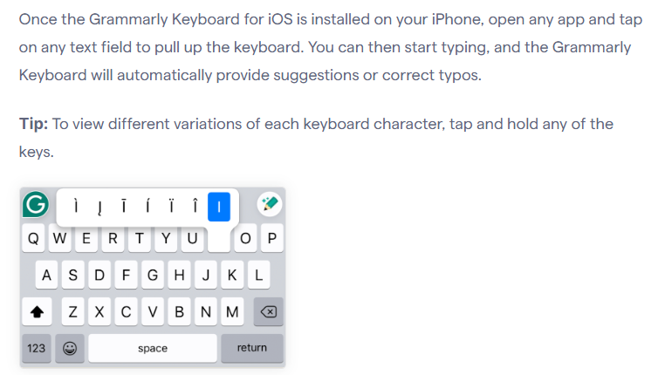
Grammarly Mobile
Notes:
https://support.grammarly.com/hc/en-us/categories/115000018631-Tips-Tutorials

Slide 16


